Slide 1
Some thoughts on the status of our service design effort as we go on our Christmas break.

Slide 2
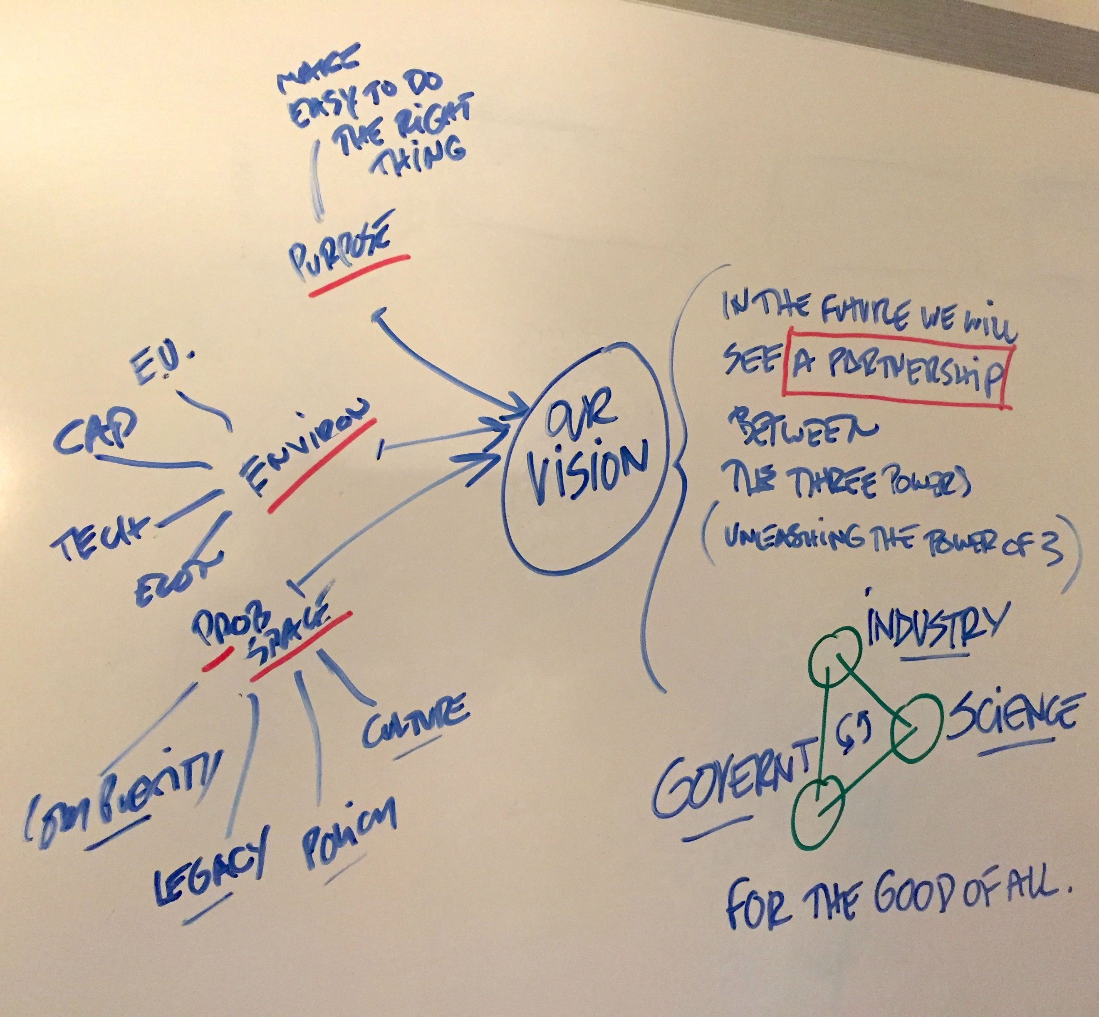
1) We defined our vision
We gathered in a strategy workshop to define our vision:
“In the future, we will see a strong partnership between industry, government and science that will bring better outcomes for all”
You could call this unleashing the “power of three”

Slide 3
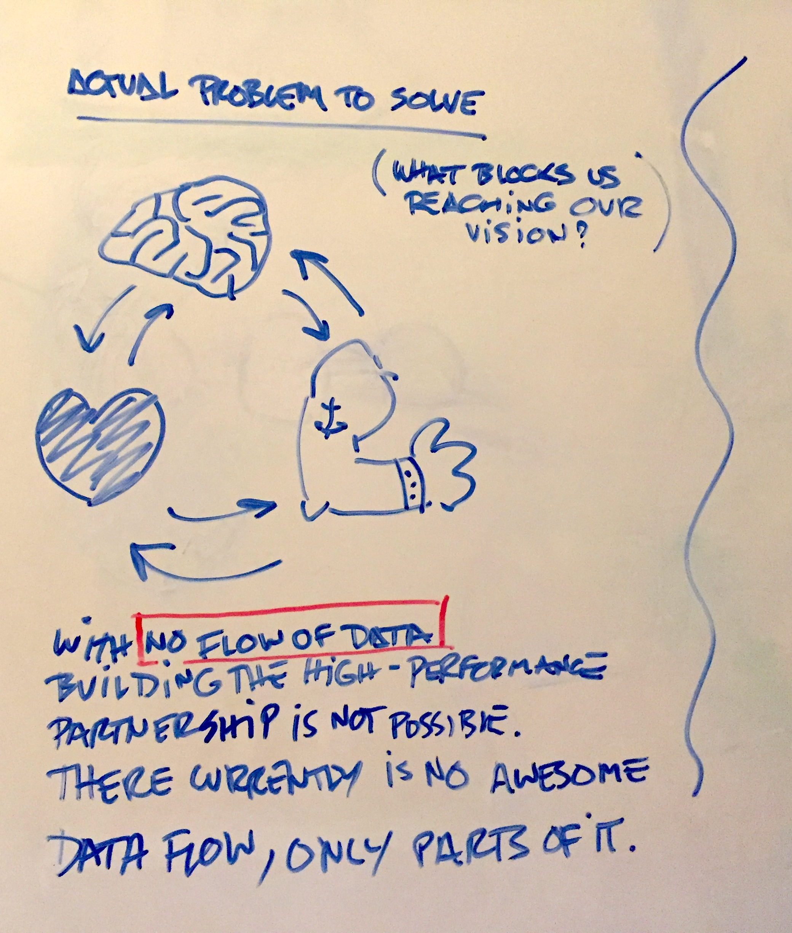
2) We found our “actual problem to solve”
We described our “actual problem to solve”, the problem that is preventing us reaching our vision.
We described it as there not being a good flow of reliable traceability data between the three stakeholders (industry; science; government).
Without the flow, the future partnership cannot work, so our job is kick-starting this ‘cardio-vascular’ system of traceability data.

Slide 4
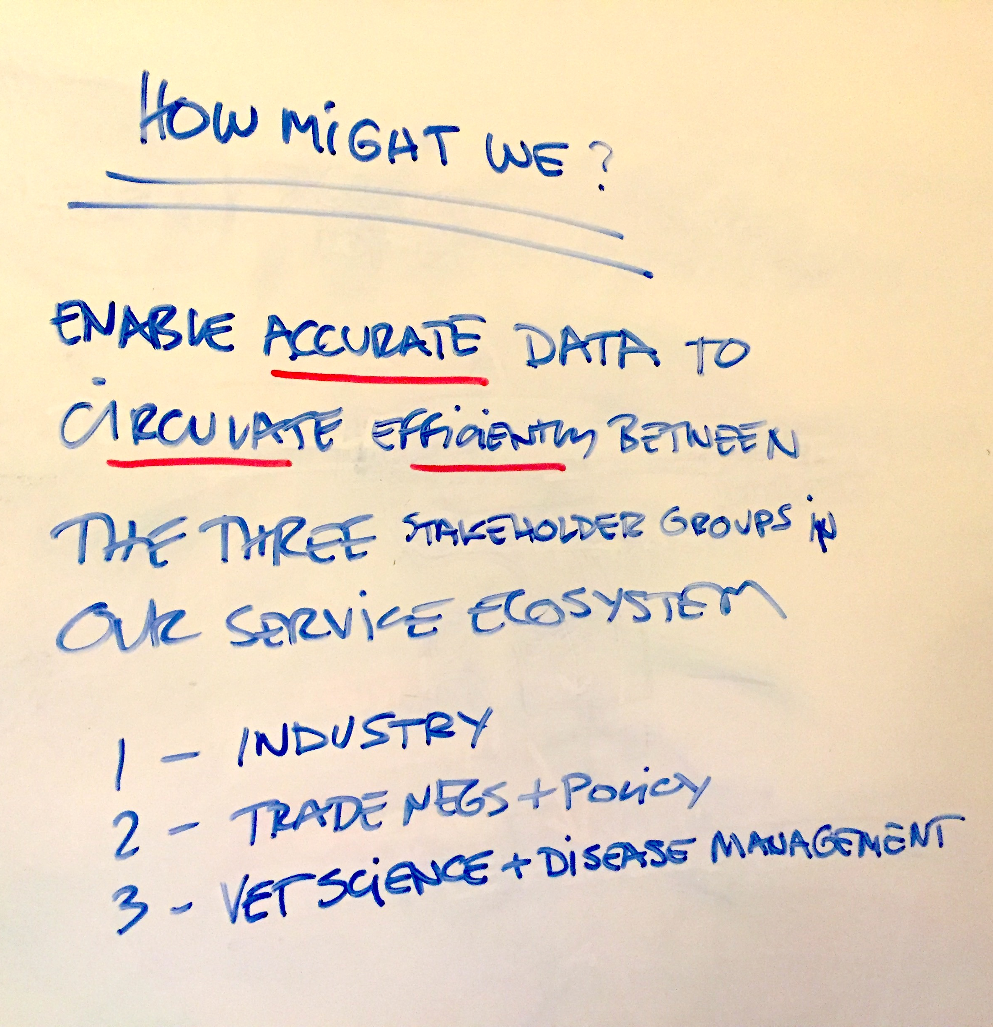
3) We framed the HMW question
We framed our problem in the format of a “how might we” question.
This format is used in the design thinking process as a driver for innovation and finding creative solutions.
“How might we enable accurate data to circulate efficiently between the three stakeholder groups in our service ecosystem?”

Slide 5
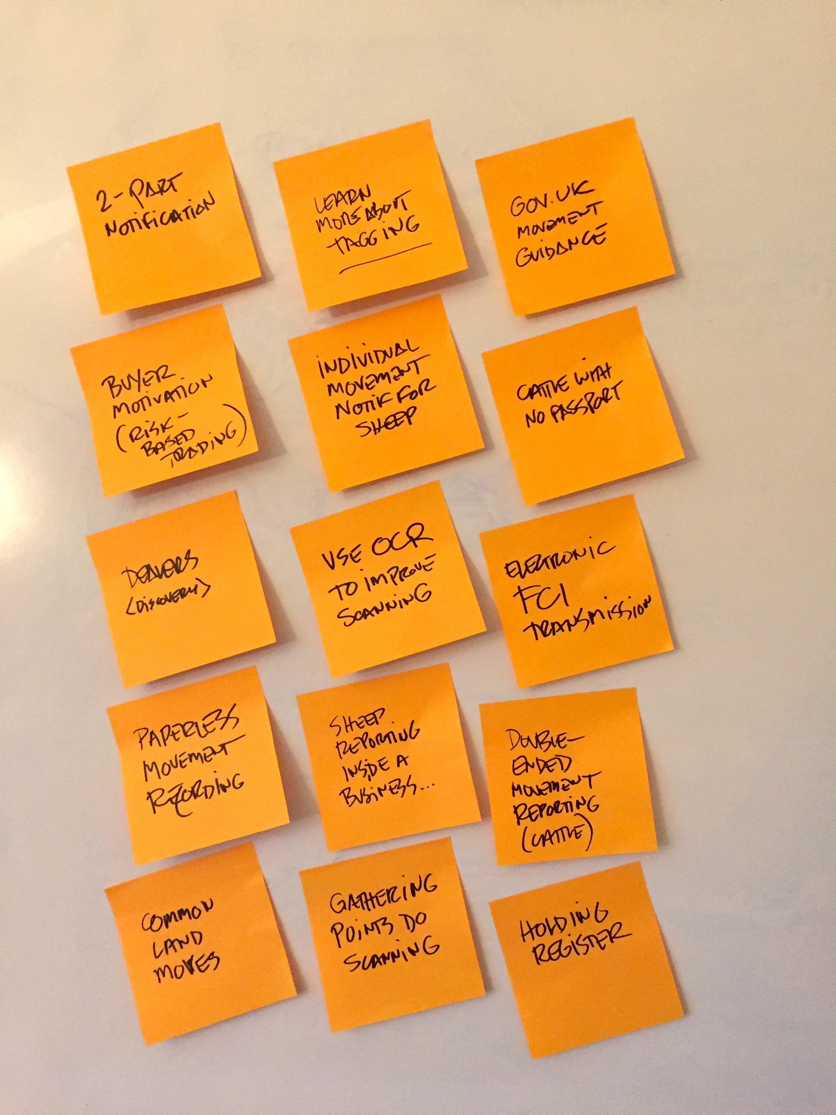
4) We brainstormed possible ways to answer the question
In the last part of our strategy day workshop we wrote ideas on post-its. These led to initiatives or areas of strategic focus to drive the next phase of design exploration.
A few of these suggestions were new and many of them were based on issues that had been under review for some time.

Slide 6
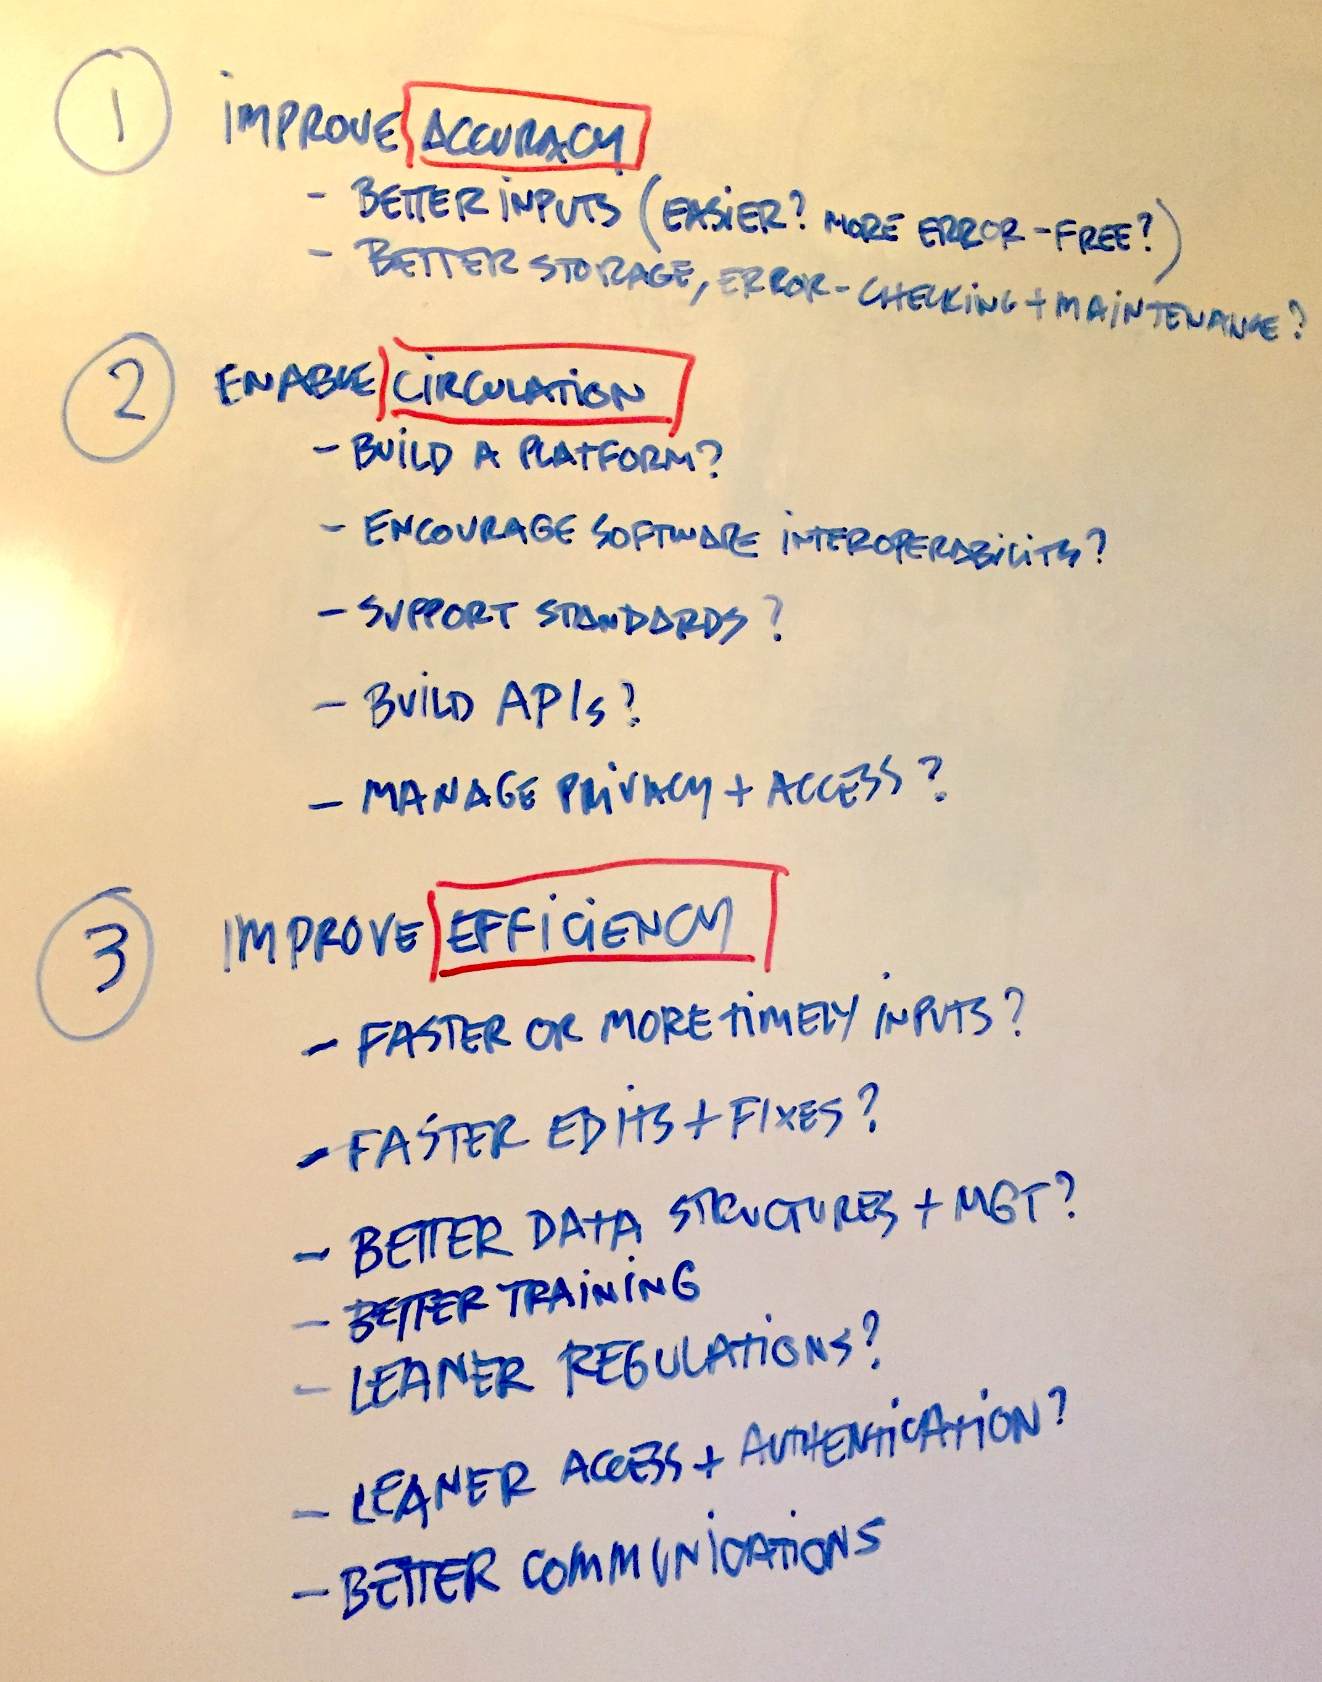
5) We started the design exploration phase called “speculative design”
In this design phase we have started mocking up and testing some of the proposed ideas. These have been explored in role-play workshops, journey mapping sessions and co-design sessions with TDUG members.
We have been driven by initiatives that can be traced back to our chosen problem. That is, the solutions either improve accuracy of traceability data; enable circulation of data; or improve the efficiency of the flow of data.

Slide 7
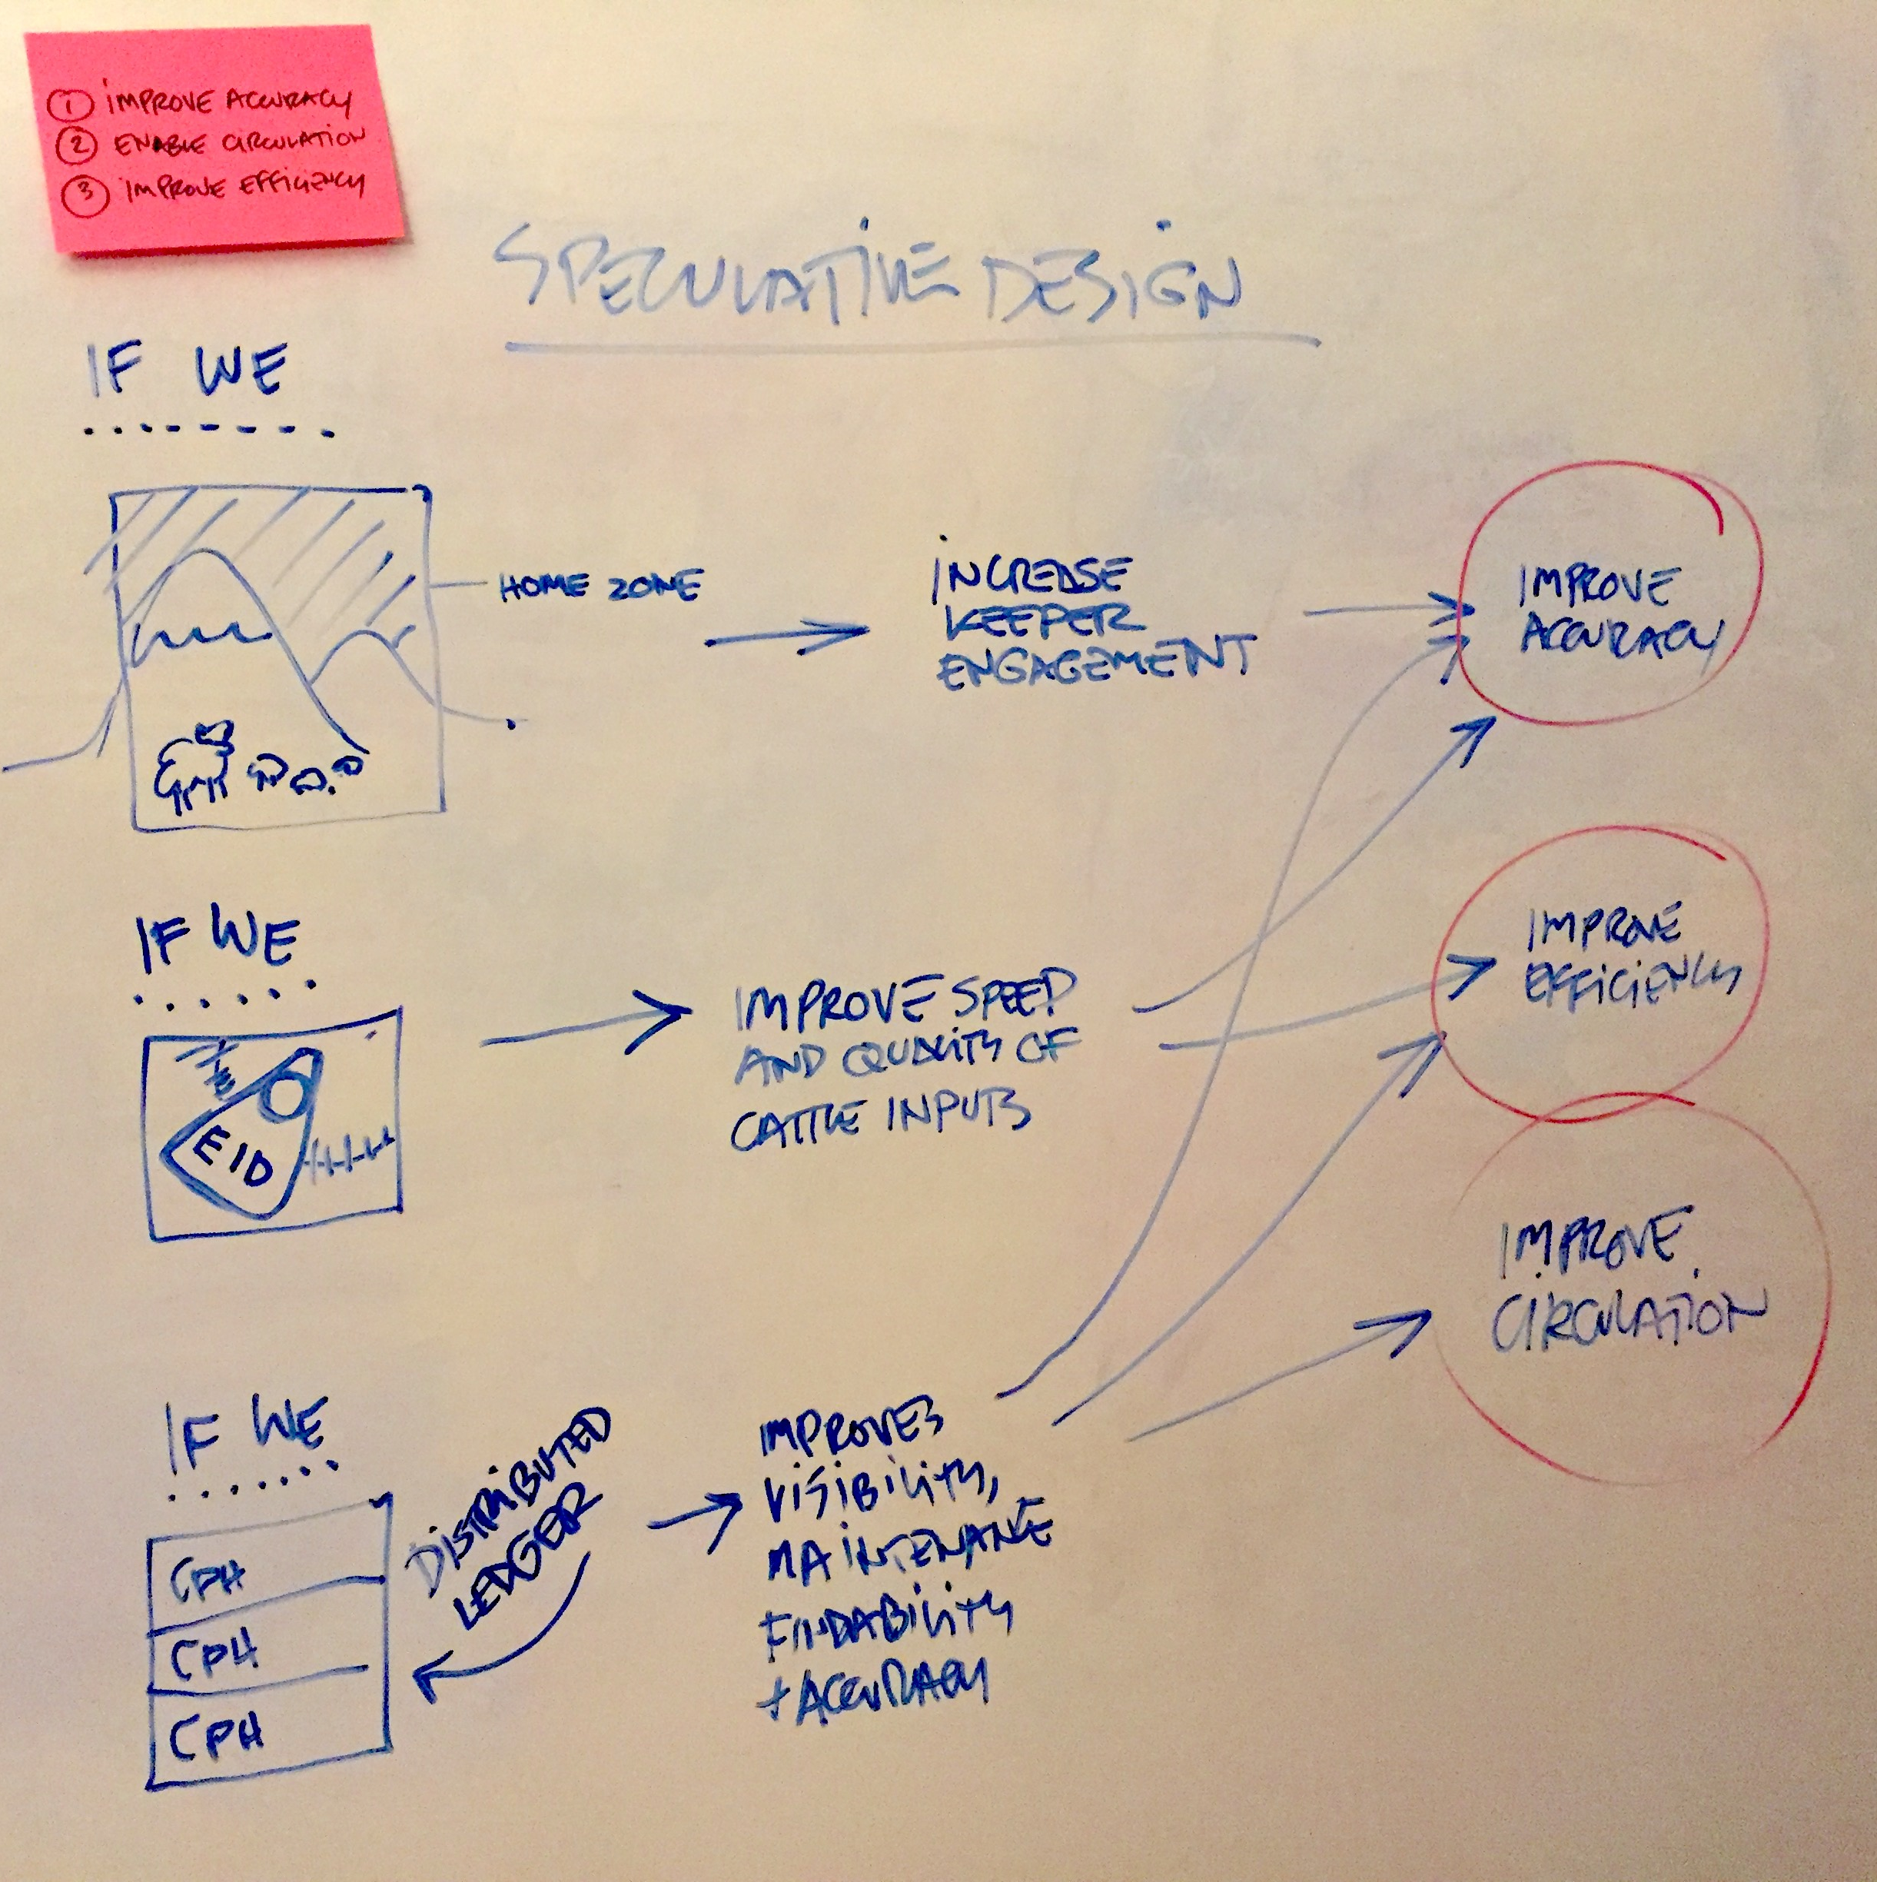
6) We ensure exploration can be traced back to the “actual problem to be solved”
We have many initiatives to explore and no doubt others will appear as we discover hidden potential.
This whiteboard shows three of the initiatives (home zones, bovine EID, distributed ledger) mapping to “the actual problem to be solved”

Slide 8
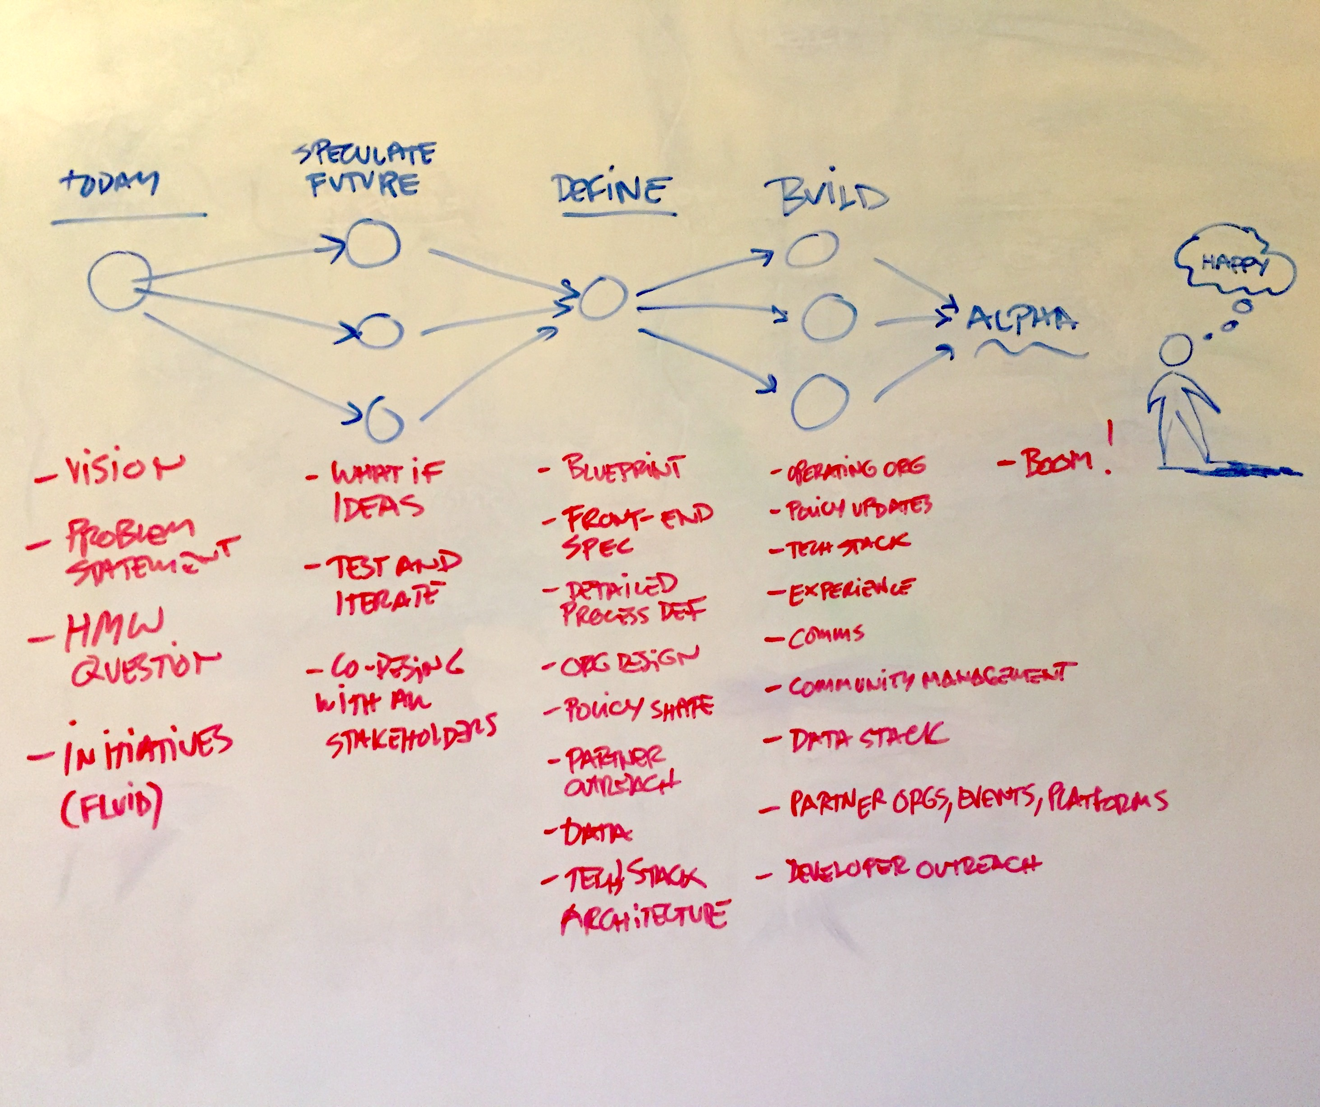
What’s next?
In the new year, if possible, I would like to complete speculation and have started high-level definition by March 2018.
At that stage, we should have a number of compelling, interactive prototypes and all the stars well aligned for productive definition and build phases.

Slide 9
So Merry Christmas all and see you for exciting times in the new year☺
Dug Falby 22 December 2017

